Slide 1
Acceptance & Usability Testing
Testing Exam 2021 Tariq

Slide 2
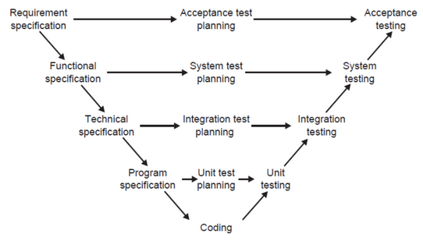
Acceptance Testing
What is it?
Tests if the system meets:
Requirement Specification
Expectations
Technical test of quality assurance
Black-box testing technique
Does it match the user’s business needs?
Each requirement should be testable
Why?
Dev team gets feedback from users
Clarify requirements
Way of measuring if product is finished
Gives involved people a common understanding of requirements
Who?
Responsibility of customers
Project members can be involved too
Acceptance testing checks:
Functionality
User interface
Data quality
Operations
Forms and reports
Capacity and volume
Reliability, availability and stability
Error / disaster handling and recovery
Performance
Localisation
Compatibility
Standards Compliance
Installation, setup and initial configuration

Slide 3
User Acceptance Test | Types
User Acceptance Testing (UAT) | Contract and Regulation Acceptance Testing | Alpha and Beta testing:
Tests if product meet client business needs | Contractual: If Acceptance criterias are documented in a contract → Are these criterias met? | Alpha → Tested at developer’s site
Done by a user representative | Regulation: Regulatory systems (legal, governmental & safety standards) → Are these criterias met? | Beta → Tested at customer’s site

Slide 4
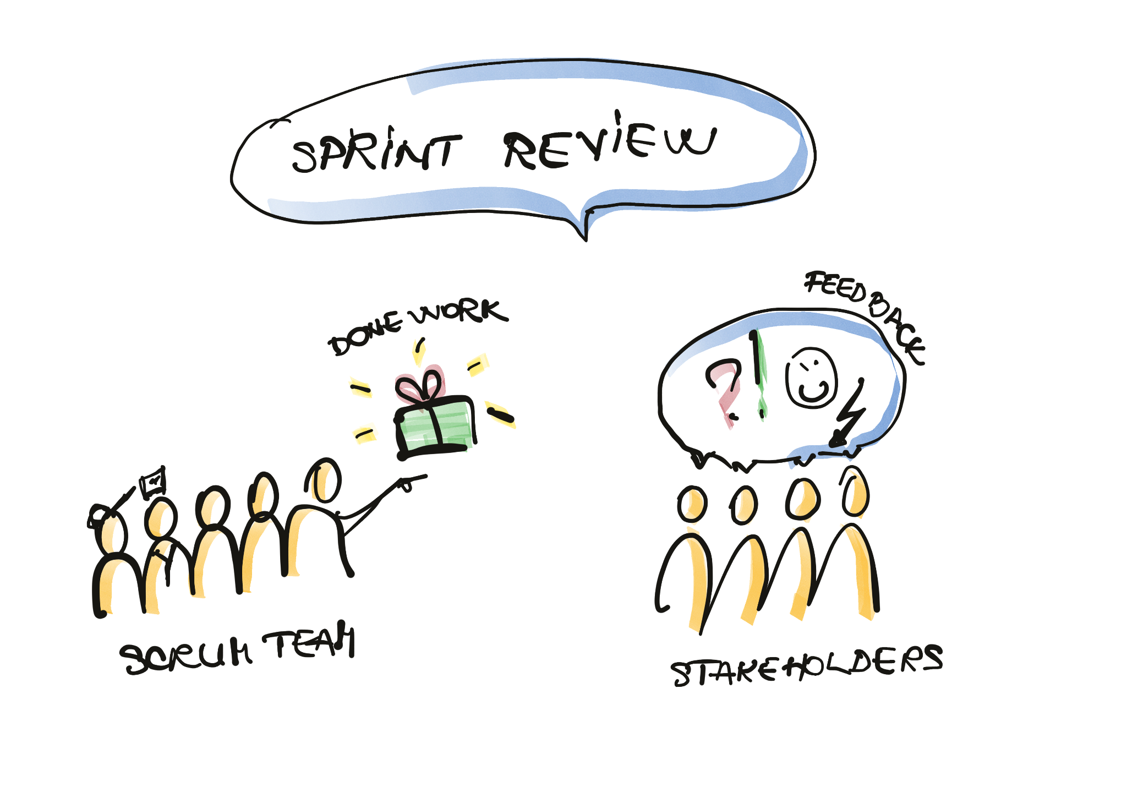
Agile and acceptance testing
Internal → Further testing can be required before delivery to customer
After PO’s acceptance in Sprint Review → Can require a sort of System test
What is Agile?
Large project → Small chunks → Iterations = manageable
Iterations → Consistent time periods
No known limit but usually 1 week or 1 month
Product delivery at the end of every iteration
Next delivery will build on the previous one
What does Acceptance have to do with Agile?
Sprint review → Acceptance testing
End of sprint → Product → sprint review → feedback → New requirements for next product → Develop → End of sprint …
Product Owner (PO) can decide if product is ready to be released

Slide 5
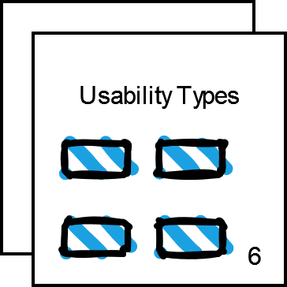
Usability Testing
What is Usability Testing?
Testing if and how usable the system is
From the user’s perspective
Often used for:
Websites
Apps
UI Systems
Measured in
Efficiency - time taken to do tasks
Effectiveness - level of skills required
Satisfaction - user’s attitude towards system
Black-box technique
Non-functional
When?
Just prior to product release (summative)
Under development (formative)
How?
Depending on the scenario, there are some methods to use [see next page]

Slide 6
Usability Testing | Types & Methods (1/2)
Types:
Formative:
Performed while in development
Summative:
Performed after product is developed
Methods:
Labs (moderated)
Lab environment
Trained professional = Moderator
Computers / tablets for testers
Moderator interacts with tester & asks them questions → Documents data
Advantages:
In-depth results
Controlled environment & same conditions
Disadvantages:
Expensive
Time consuming

Slide 7
Usability Testing | Types & Methods (2/2)
Phone Interview (remote)
Conducted verbally through phone but testing is done with computer
Data recorded and documented by moderator
Advantages:
Cheap
Enormous range of tester options
Disadvantages
Not personal
Eye Tracking
Tracking of participant’s eye movement
Tests participant’s attention during tasks
Advantages:
Unique and useful data
Can produce Heatmap diagram / Movement path diagram
Disadvantages:
Expensive
Requires lab
Dedicated software
Calibration of machine
Special equipment

Slide 8
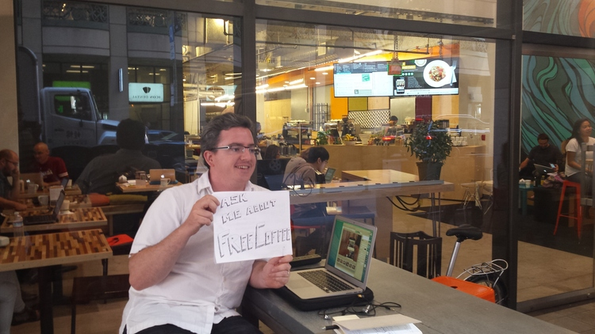
Guerilla Testing
What is it?
Simplest form of Usability Testing
How?
Public place
Cafe, restaurant, park
Random test subjects
Quick tests
Provide rewards
Coffee
Giftcard
Advantages:
Cheap and real-user feedback
Disadvantages:
Can’t entirely if subjects are target subjects

Slide 9
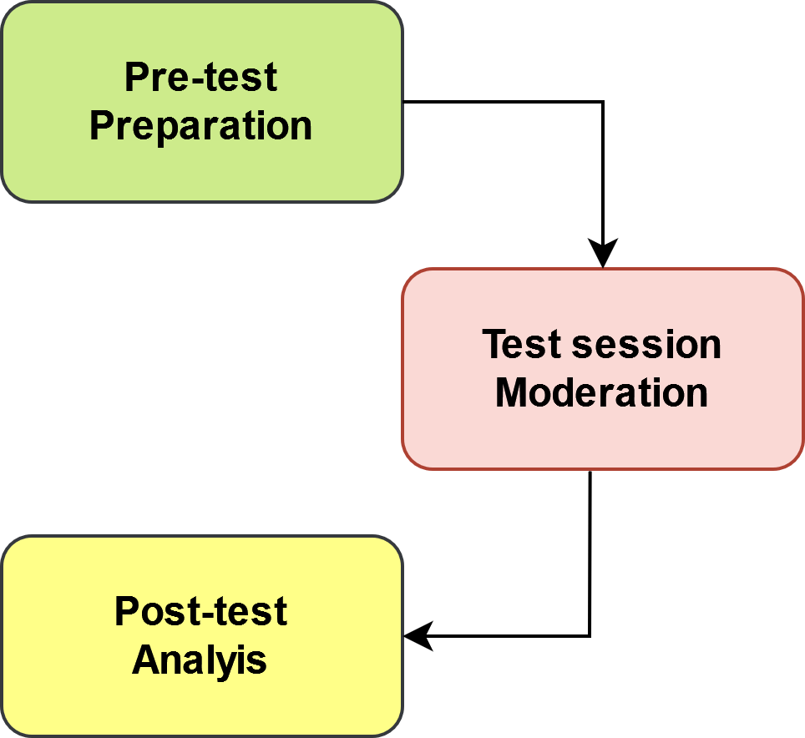
Phases of Usability Testing
Pre-test, Test session & Post-test
Preparation
Define the users
Recruit the testers
Define the measures
Preferences
Usability
Desirability
Performance
Time spent on each task
Errors
Prepare the procedures
How
When
Where
Duration
With whom
What materials
Prepare the script
Scenario
Tasks
Prepare prototype (Can be avoided)
Prepare consent form that has the following:
Goal of test
Procedure
Duration
Participant’s rights
Begin the testing
Moderation
Welcome the testers
Introduce the test
Obtain the informed consent
Explain the protocol of thinking loud
Record / take notes of the process
Testers / participant’s perform the tasks
After the testing → Debriefing and rewards to tester
Analysis
Process the data achieved by the process
Quantitative
Qualitative
Prioritise the usability problems found
Communicate the results

Slide 10
Demonstration | Selenium
Acceptance Testing

Slide 11
Thanks!

